Slide 1
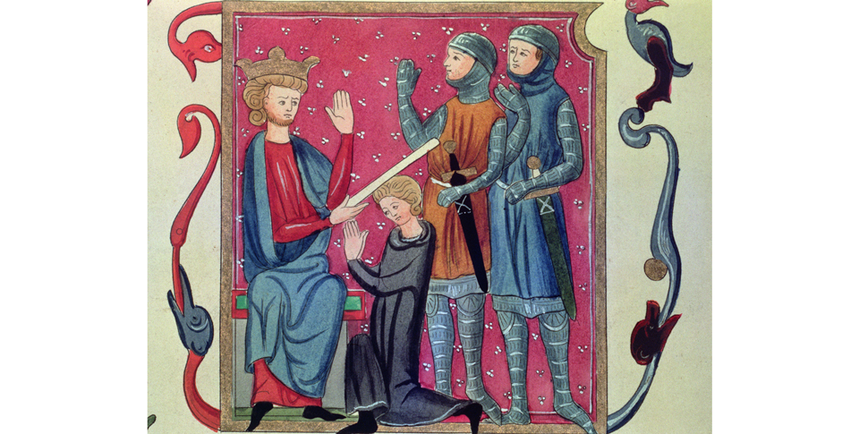
Medieval Christian Europe (330–1450)
Topic 1 Lesson 2 Feudalism and the Manor Economy

Slide 2
Medieval Christian Europe (330–1450)
Topic 1 Lesson 2 Feudalism and the Manor Economy
Learning Objectives
Describe the development of the political and social system of feudalism.
Summarize the life of knights and nobles.
Analyze how the economic system of manorialism worked and how it affected peasants and nobles.

Slide 3
Feudalism Develops
In the face of invasions by Vikings, Muslims, and Magyars, kings and emperors were too weak to maintain law and order.
People needed protection for themselves, their homes, and their lands.
In response to this basic need for protection, a decentralized political and economic structure evolved, known as feudalism.
Feudalism was a loosely organized system of rule in which powerful local lords divided their landholdings among lesser lords. In exchange, these lesser lords, or vassals, pledged service and loyalty to the greater lord.

Slide 4
Feudalism Develops
A monarch dubs a kneeling young man a knight. Two knights sponsor and stand by him in this French illustration from the late 1200s.

Slide 5
Feudalism Develops
Feudalism was based on mutual loyalty and obligations. Analyze Information What were some of feudalism’s advantages and disadvantages for medieval knights and peasants?

Slide 6
Nobles, Knights, and Warfare
During the Middle Ages, warfare was constant.
For medieval lords and vassals, it was a way of life.
Rival lords battled constantly for power.
Both greater and lesser nobles trained from boyhood for a future occupation as a knight, or mounted warrior.

Slide 7
Nobles, Knights, and Warfare
The Life of a Knight
Starting at age 7 boys were sent to learn how to ride, fight, take care of arms and weapons
Upon finishing they were dubbed knights
They fought on horse back with swords, axes, and lances, and wore armor and shields
They competed in tournaments, mock battles, to keep skills sharp
The Lives of Noblewomen
When men went off to fight, the women took charge. They supervised the household, managed vassals, and performed agricultural and medical tasks.
Her right to inheritance is severely limited at this time
Before she is married off she is expected to know how to spin and weave, and supervise servants.

Slide 8
Nobles, Knights, and Warfare
The Code of Chivalry
Required knights to be brave, loyal, true to their word
They had to fight fairly, for example they had to let an opponent put on his armor
They had to treat enemies well and release them if the captured knight pledged to pay a ransom
Chivalry rules applied mostly to nobles
Chivalry also asked knights to protect the weak, like peasants and noble women. This will lead to putting women on a pedestal
This will lead troubadours to compose songs and poems that will lead to our idea of romantic love today

Slide 9
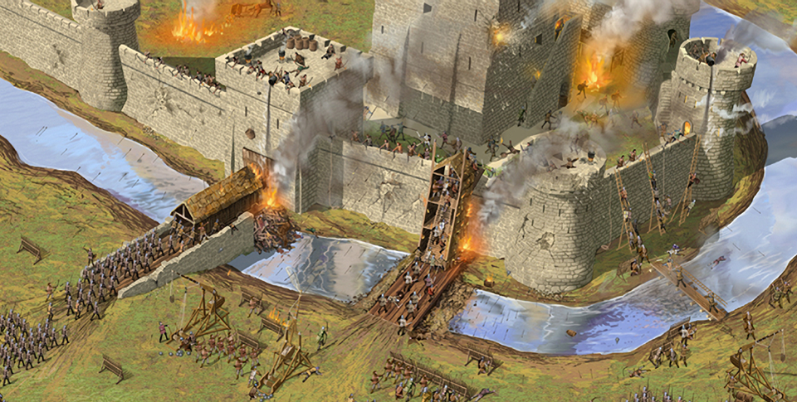
Nobles, Knights, and Warfare
Castles and War
Castle warfare in the Middle Ages was brutal. As shown in this illustration, battering rams, catapults, and fighters on ladders assaulted stone walls. Defenders shot arrows and poured hot oil on attackers.

Slide 10
Manorialism
The heart of the medieval economy was the manor, or lord's estate. Most manors included one or more villages and the surrounding lands. Peasants, who made up the majority of the population in medieval society, lived and worked on the manor.
An Economic System
The Lord provided justice and provided land and protection and in return the peasants owed the lord labor and goods.
The Mutual Obligations of Lords and Peasants
In exchange for labor the peasants from the lord received: land to farm for their own, protection from raid and warfare. This system will support Feudalism

Slide 11
Manorialism
A Self-Sufficient World
In the manor almost everything needed was made there. There is no schooling and no knowledge of the outside world.
The Life of a Peasant
Life is harsh for peasants. Hard labor all day. Food was black bread and vegetables. Very rarely is there meat to eat.
Seasons and Celebrations
Spring, summer, and fall was work intensive. Winter was restful but food could run out. Celebrations include births and marriages, Easter and Christmas and other holidays.

Slide 12
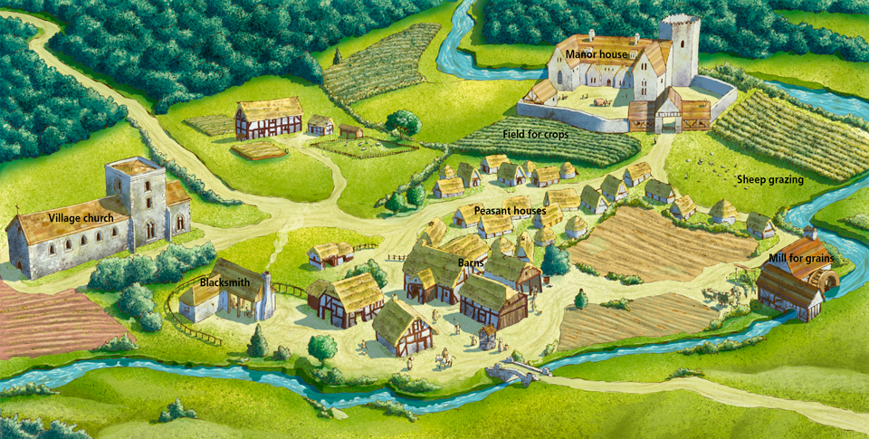
Manorialism
A bird’s-eye view of a typical medieval manor, which might include a manor house, a village church, a grain mill, storage barns, a blacksmith's shop, clustered peasant huts, and fields for crops and grazing.

